Slide 1

Movement and Control of Biomimetic Humanoid Robots

Slide 2
A summary of my talk will help you focus on three key areas:
Robot development
Neural controller development
Future work to integrate both these things

Slide 3
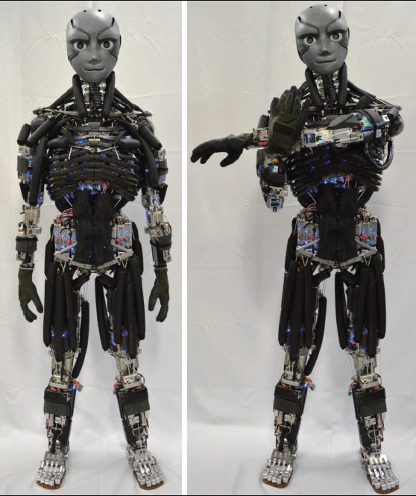
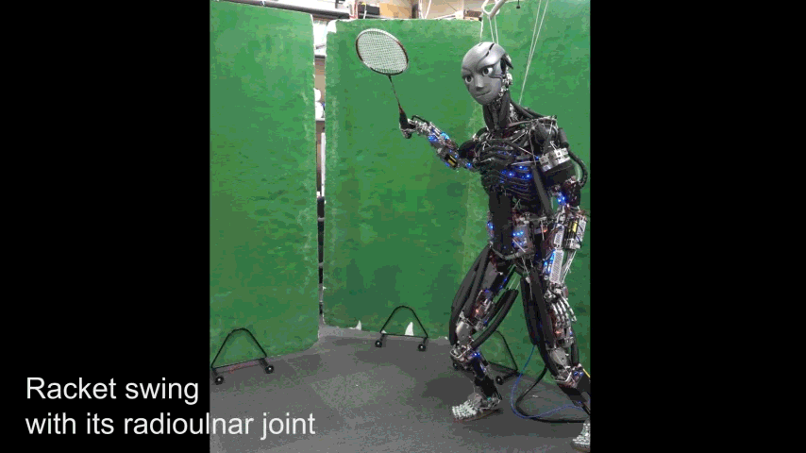
Biomimetic humanoid robots can test and deepen our understanding of how the human body moves.
Asano, Y., et al. (2016, November). Human mimetic musculoskeletal humanoid Kengoro toward real world physically interactive actions.
In 2016 IEEE-RAS 16th International Conference on Humanoid Robots (Humanoids)(pp. 876-883). IEEE.

Slide 4
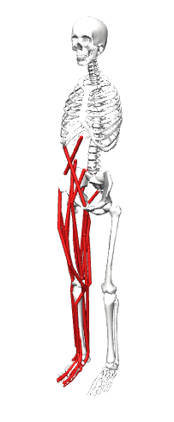
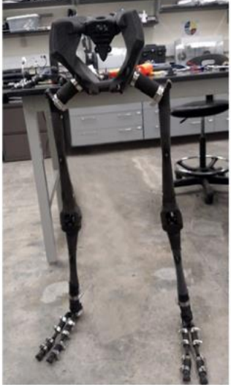
In the AARL we are designing and building a bipedal robot with a 3D printed skeleton and artificial muscles to mimic a human biomechanical model.
27 muscles per side
Bolen, Ben P., and Alexander J. Hunt. “Determination of Artificial Muscle Placement for Biomimetic Humanoid Robot Legs.” Biomimetic and Biohybrid Systems,
edited by Uriel Martinez-Hernandez et al., vol. 11556, Springer International Publishing, 2019, pp. 15–26. DOI.org (Crossref), doi:10.1007/978-3-030-24741-6_2.

Slide 5
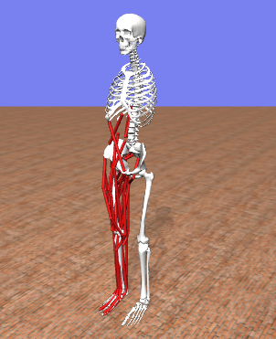
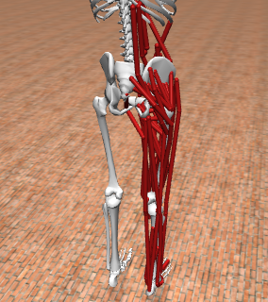
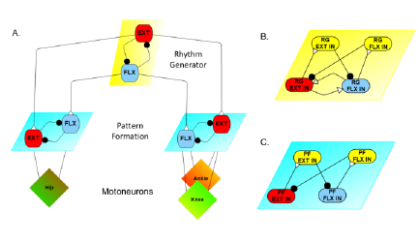
Robot control will be achieved by combining our neuromechanical model with the 3D printed skeleton and pneumatic artificial muscles.

Slide 6
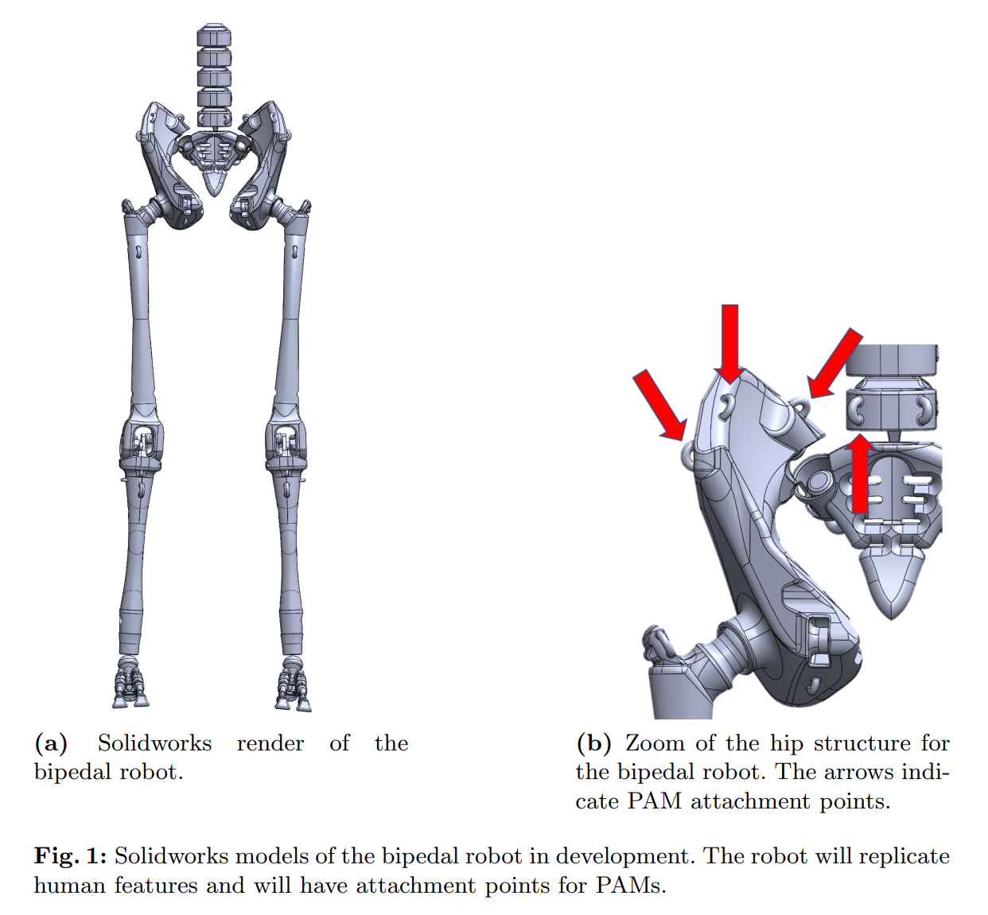
The robot will replicate human features, movements, and have attachment points (red arrows) for the muscle actuators.
Morrow, Connor, et al. “Optimization of Artificial Muscle Placements for a Humanoid Bipedal Robot.” Biomimetic and Biohybrid Systems, edited by Vasiliki Vouloutsi et al., vol. 12413, Springer International Publishing, 2020, pp. 257–69. DOI.org (Crossref), doi:10.1007/978-3-030-64313-3_25.

Slide 7
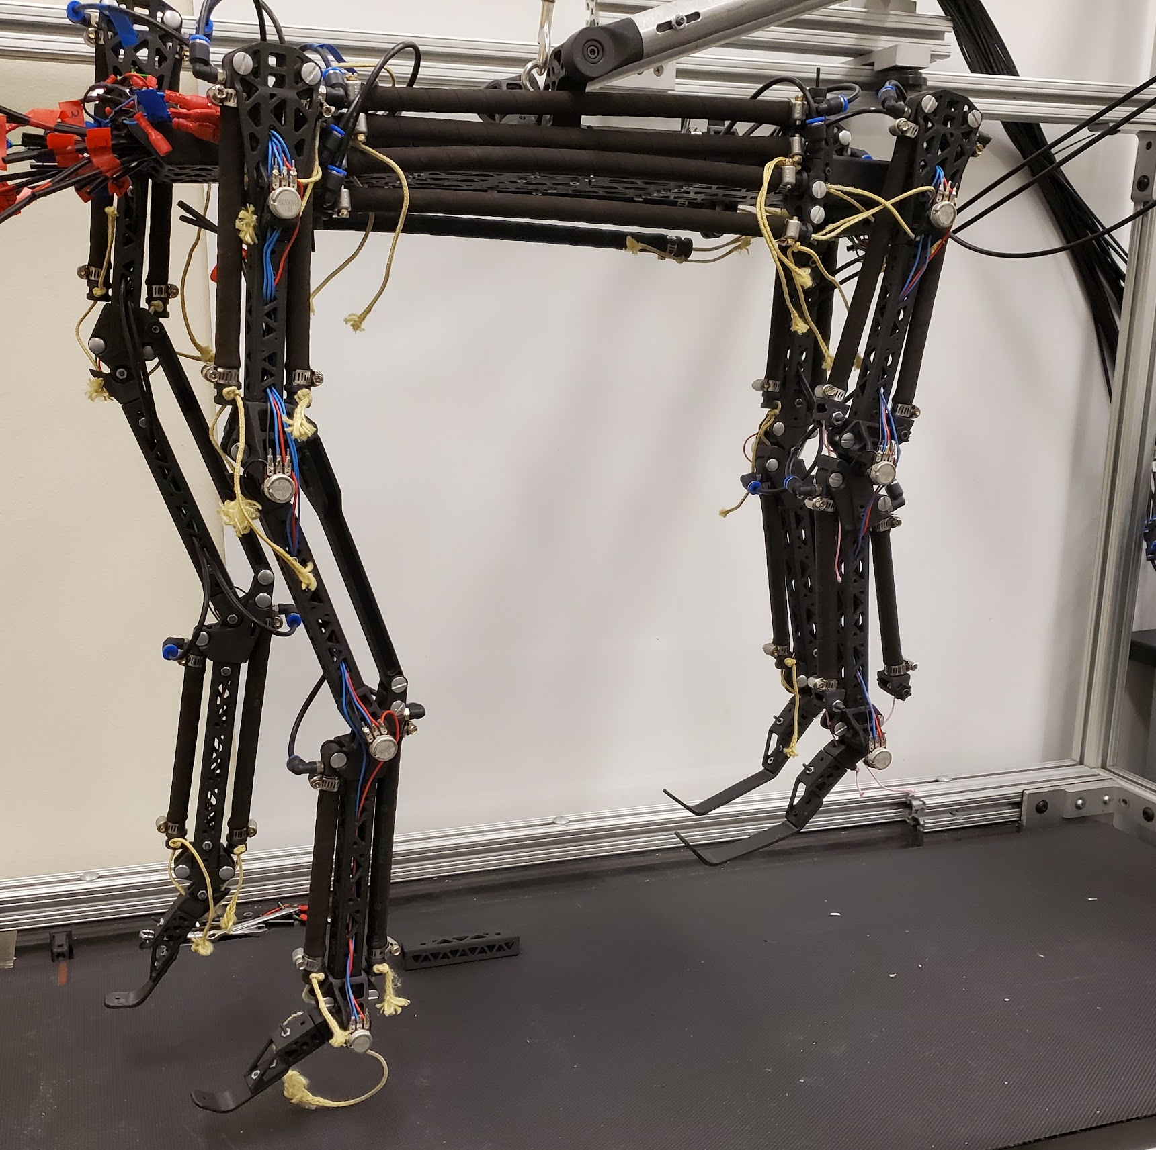
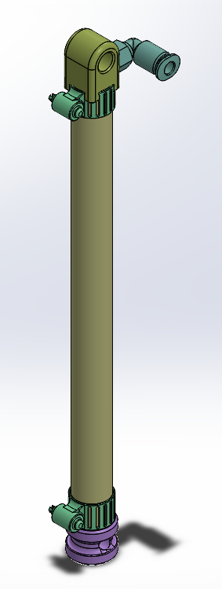
Artificial muscles have a force-length relationship like real muscles, so we use them like muscles.
In the Agile and Adaptive Robotics Lab (AARL) we use Festo Pneumatic Artificial Muscles (PAMs) to actuate biomimetic robot joints.

Slide 8
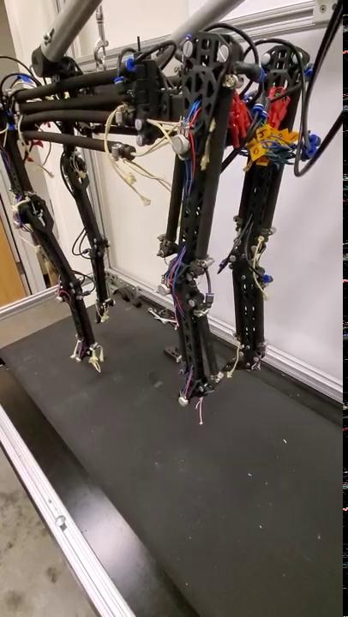
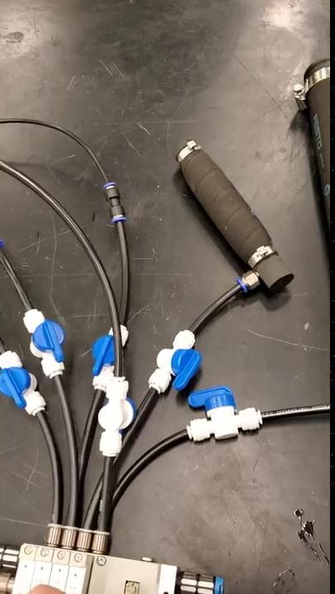
Robotic joints move when artificial muscles are pressurized.

Slide 9
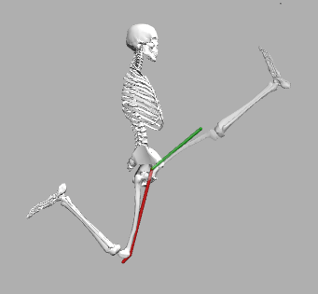
Total musculotendon length is determined by the angles of the joints, as can be seen in this muscle in its SHORTEST and LONGEST configurations.

Slide 10
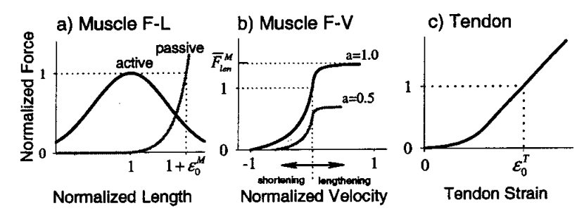
Musculotendon length determines the maximum isometric force a muscle can generate.
Thelen, Darryl G. “Adjustment of Muscle Mechanics Model Parameters to Simulate Dynamic Contractions in Older Adults.” Journal of Biomechanical Engineering, vol. 125, no. 1, Feb. 2003, pp. 70–77. DOI.org (Crossref), doi:10.1115/1.1531112.

Slide 11
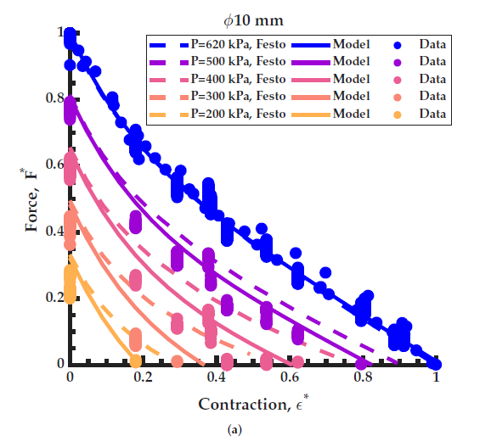
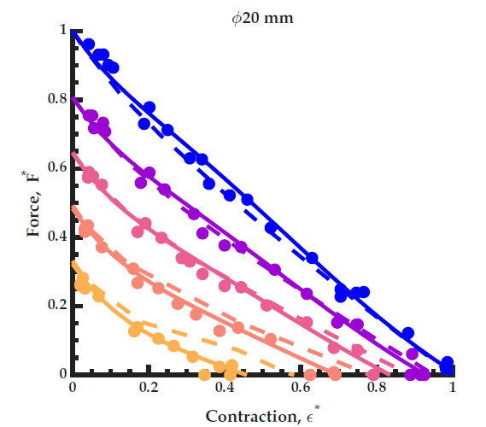
Similarly, the amount of relative contraction determines the amount of force produced by a BPA.
Bolen, Ben, et al. "Isometric Force Characterization of Braided Pneumatic Actuators." Available at SSRN 6072341.

Slide 12
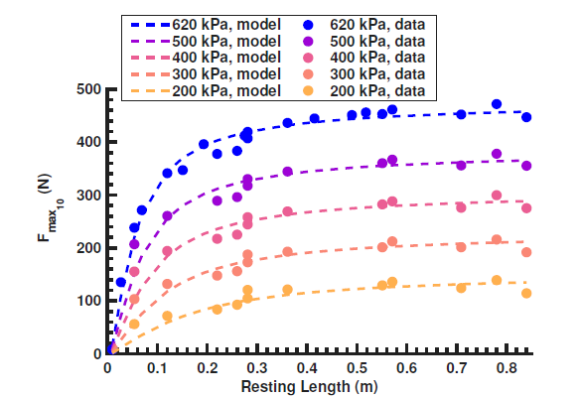
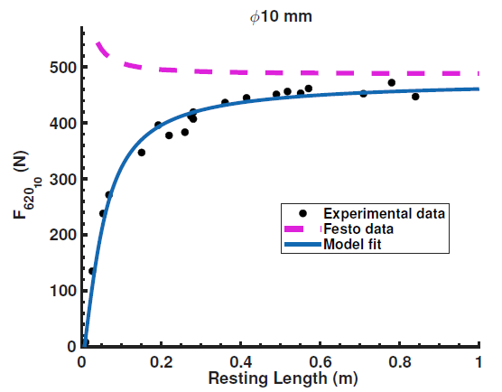
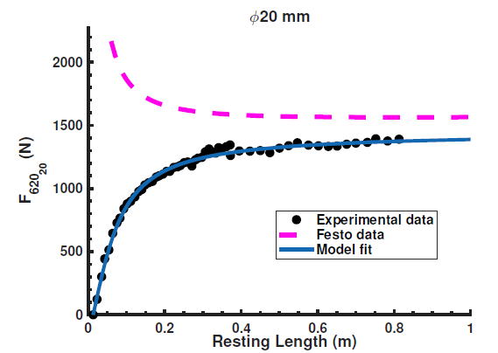
Maximum force in a BPA is a function of resting length.
Bolen, Ben, et al. "Isometric Force Characterization of Braided Pneumatic Actuators." Available at SSRN 6072341.

Slide 13
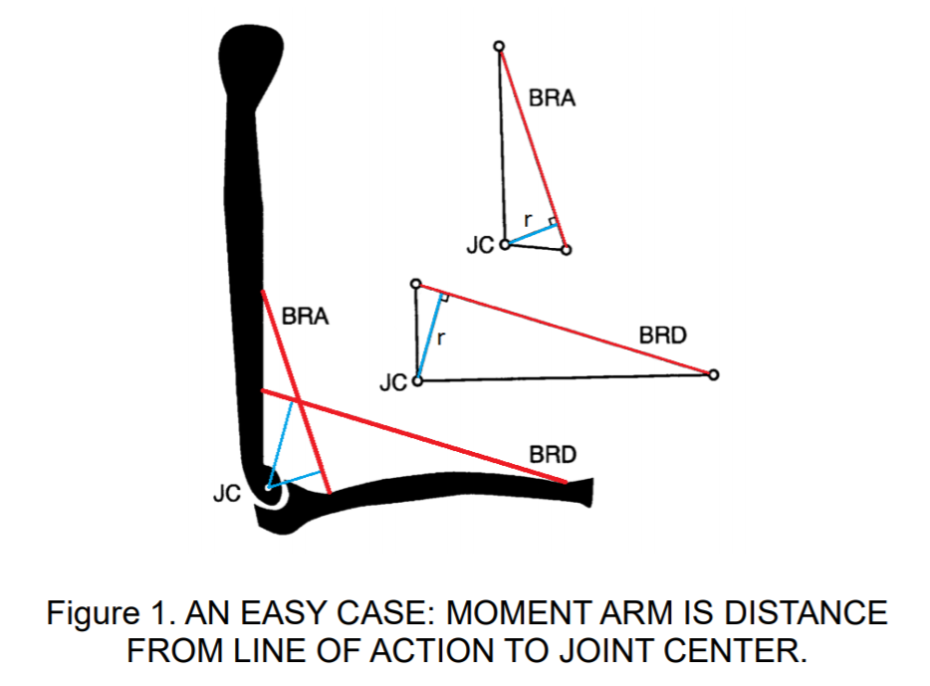
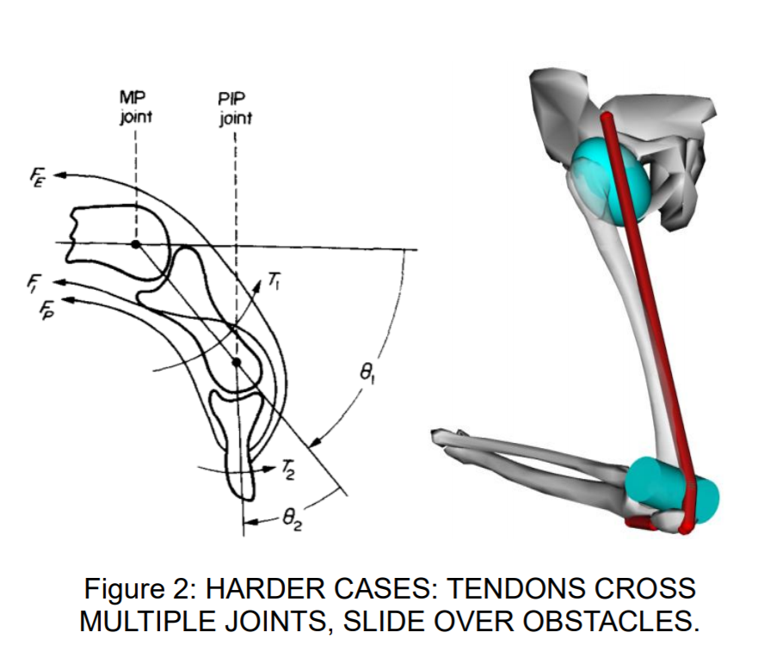
Maximum isometric torque is derived by multiplying the maximum isometric force times the shortest distance to that force’s line of action (moment arm).
Sherman, Michael A., et al. “What Is a Moment Arm? Calculating Muscle Effectiveness in Biomechanical Models Using Generalized Coordinates.” Volume 7B: 9th International Conference on Multibody Systems, Nonlinear Dynamics, and Control, American Society of Mechanical Engineers, 2013, p. V07BT10A052. DOI.org (Crossref), doi:10.1115/DETC2013-13633.

Slide 14

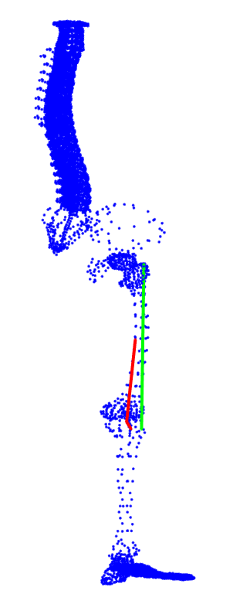
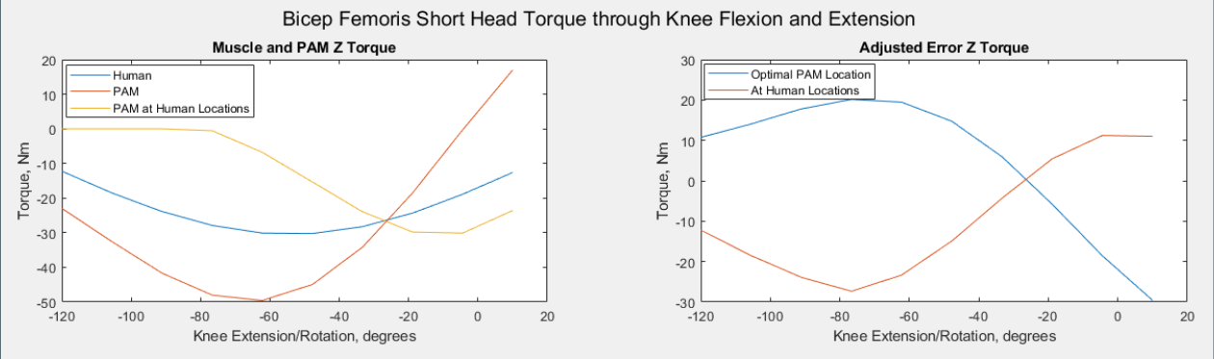
Modifying the attachment point locations by hand is a time consuming process, so we created an algorithm to automate it.
Connor Morrow
PhD Student
Morrow, Connor, Benjamin Bolen, and Alexander J. Hunt. "Optimization of artificial muscle placements for a humanoid bipedal robot." Conference on Biomimetic and Biohybrid Systems. Cham: Springer International Publishing, 2020.

Slide 15
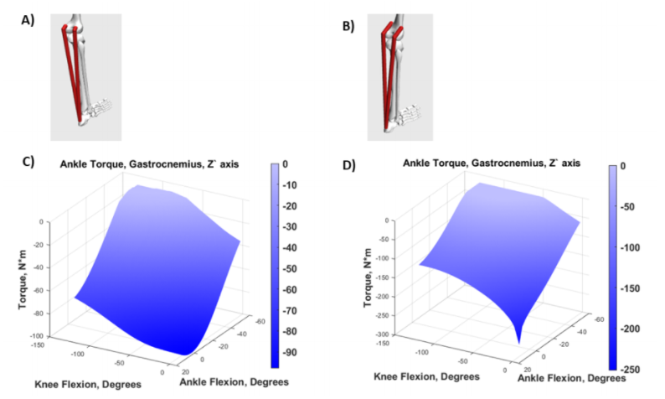
Modifying PAM attachment and wrapping locations allows the robot to meet or EXCEED the required torque for a given muscle/joint combination.
Human
Robot

Slide 16
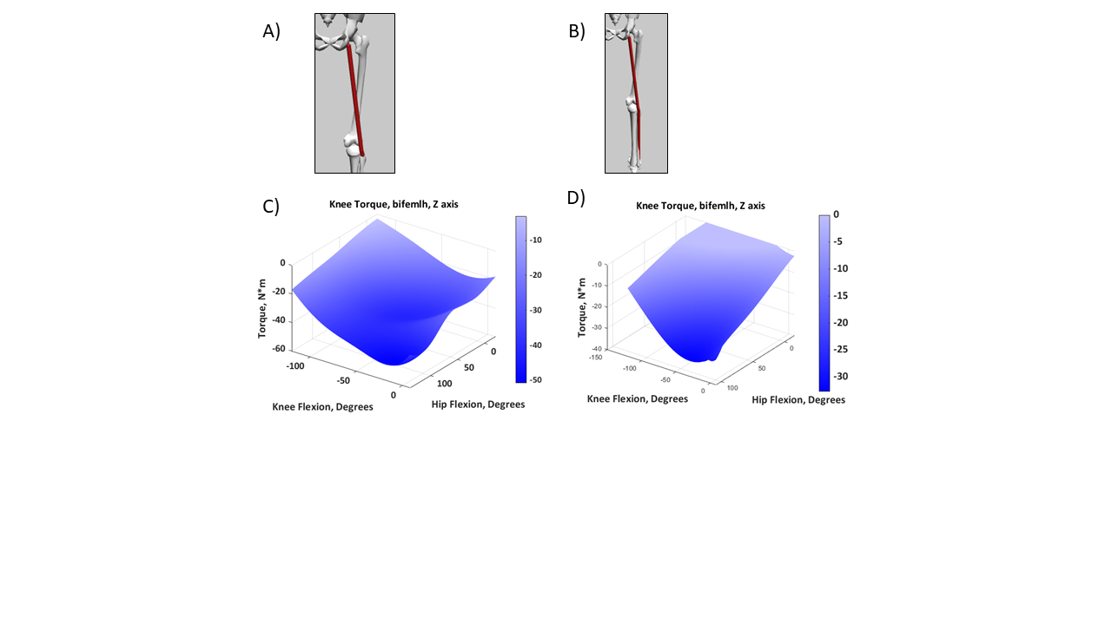
We often have to increase the actuator length because the Festo PAMs cannot contract to the same extent as real muscles.
Human
Robot

Slide 17
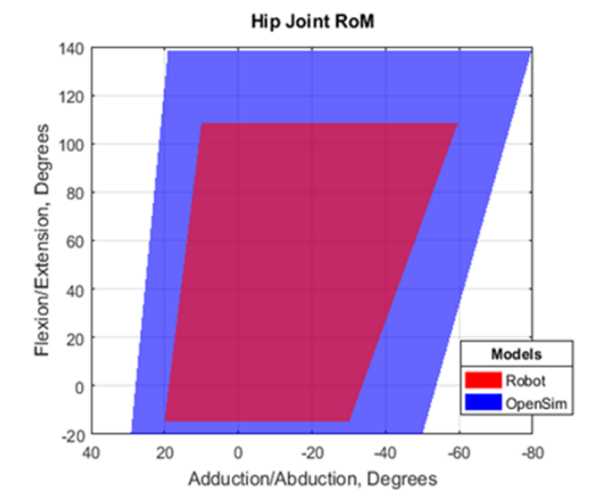
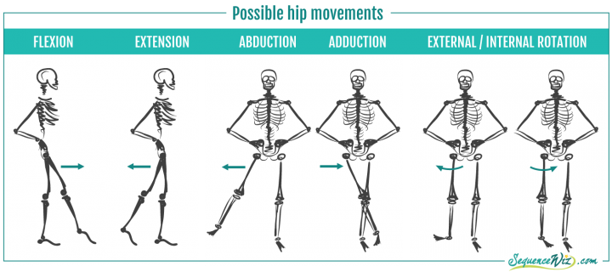
Range of motion (RoM) in our robot hip is less than the human benchmark, but greater than most traditional robot designs.
Bolen, Ben P., and Alexander J. Hunt. “Determination of Artificial Muscle Placement for Biomimetic Humanoid Robot Legs.” Biomimetic and Biohybrid Systems, edited by Uriel Martinez-Hernandez et al., vol. 11556, Springer International Publishing, 2019, pp. 15–26. DOI.org (Crossref), doi:10.1007/978-3-030-24741-6_2.

Slide 18

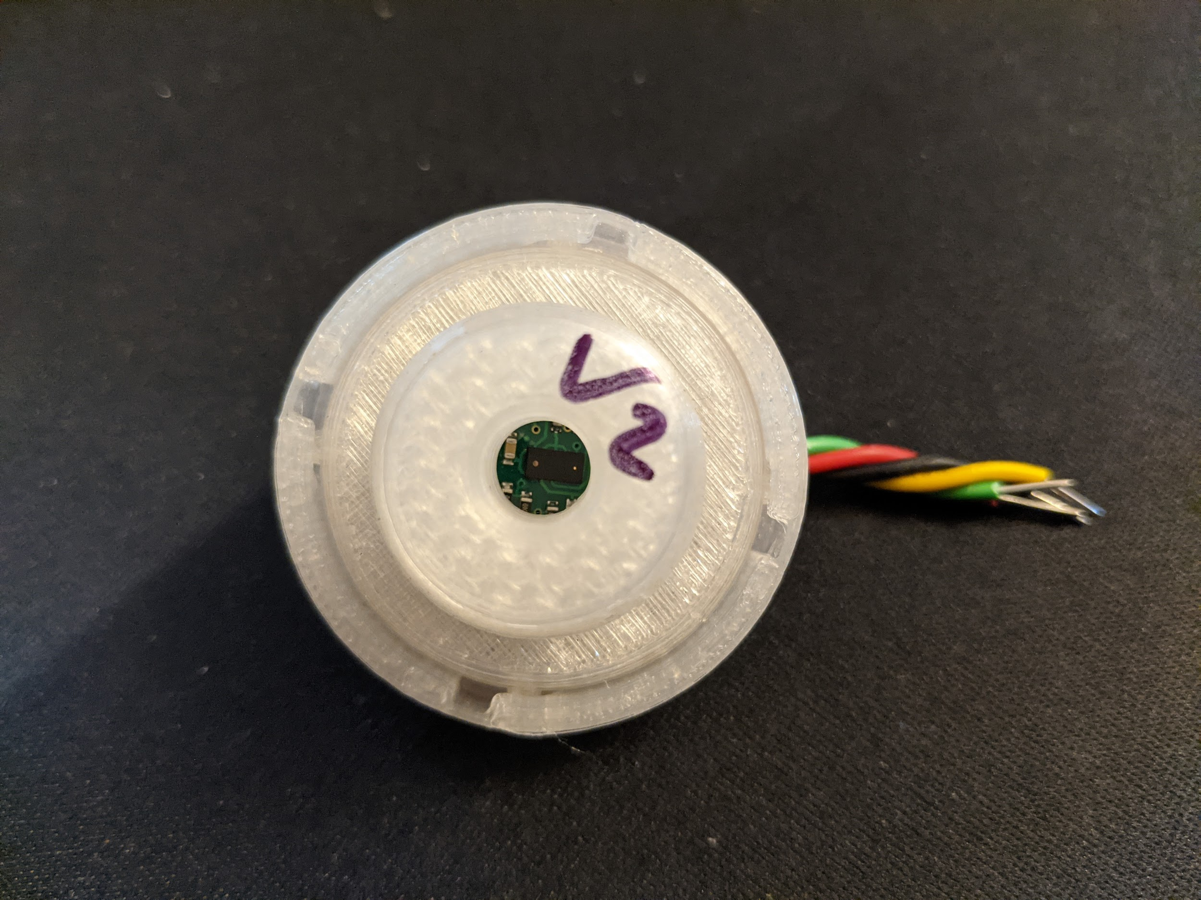
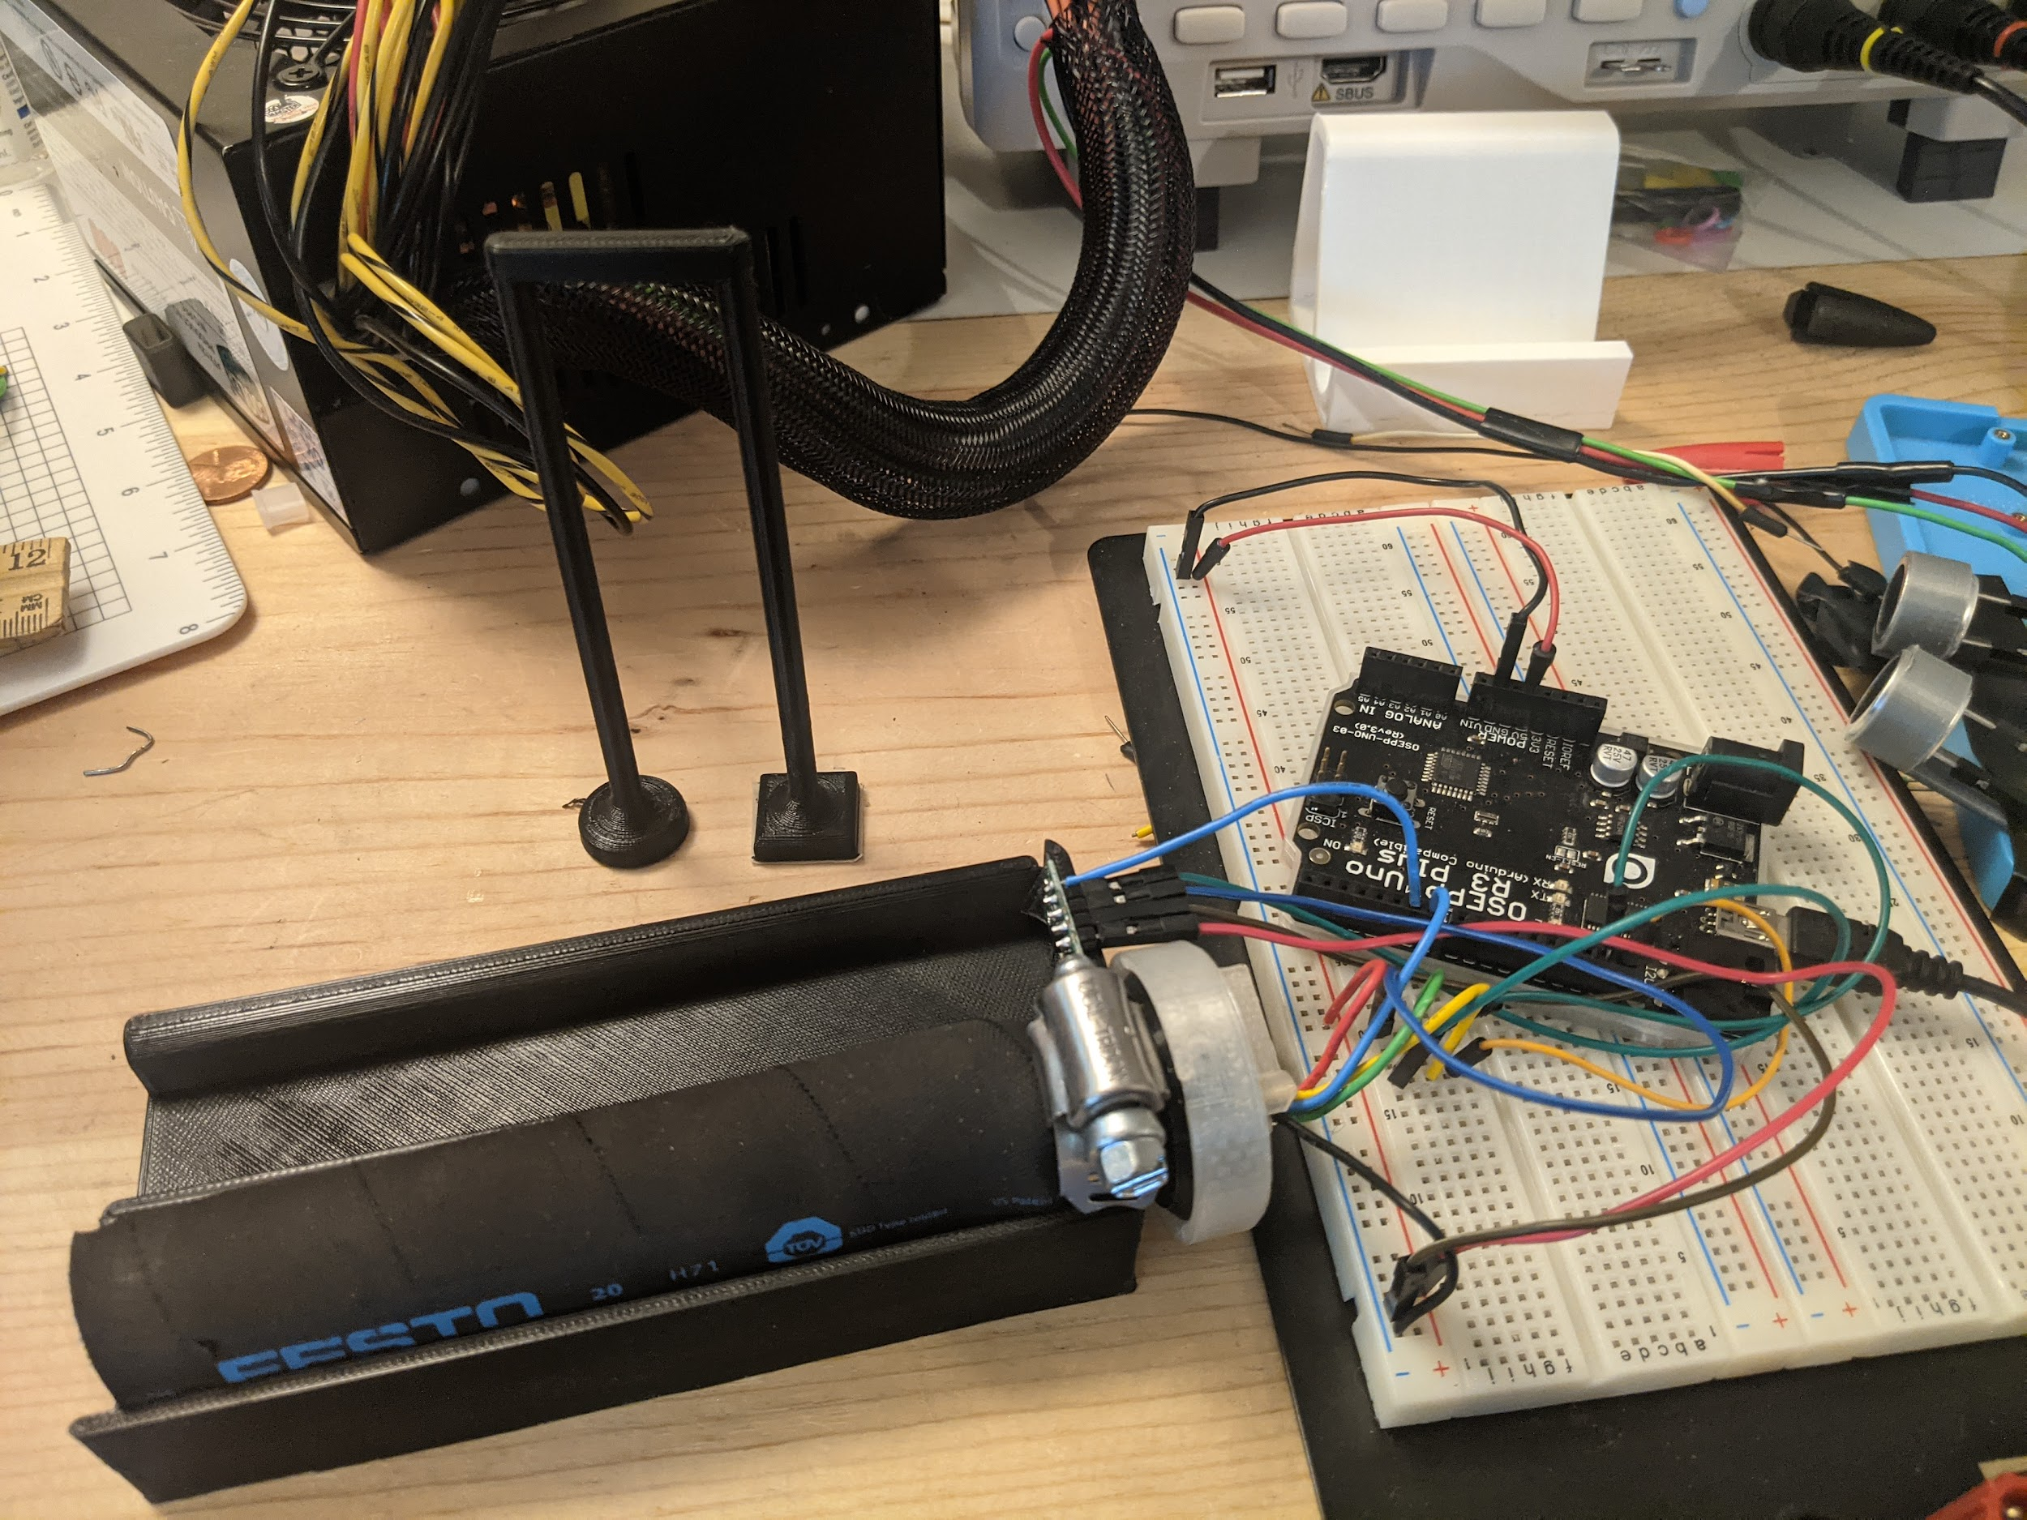
Research on technology for accurate length (and pressure) measurements will allow us to reliably calculate force.
Jake Chung
Master’s Student

Slide 19

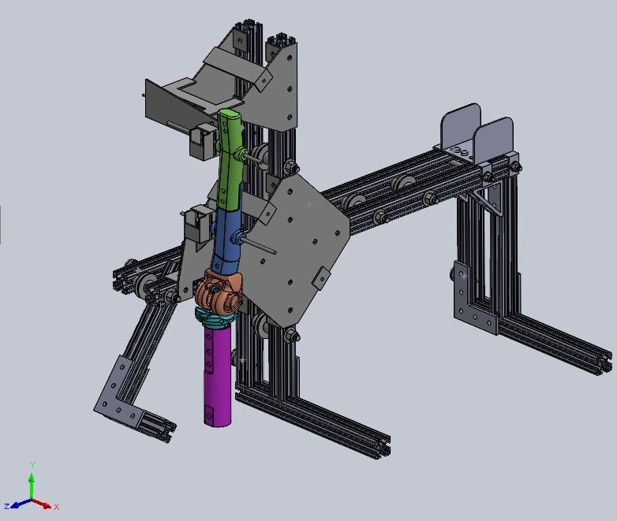
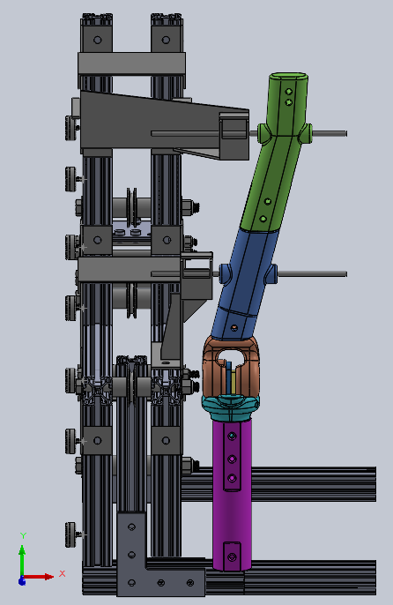
We are validating our design criteria by testing for maximum isometric force of two muscle-actuators about the knee.
Lindie Burgess
Master’s Student

Slide 20
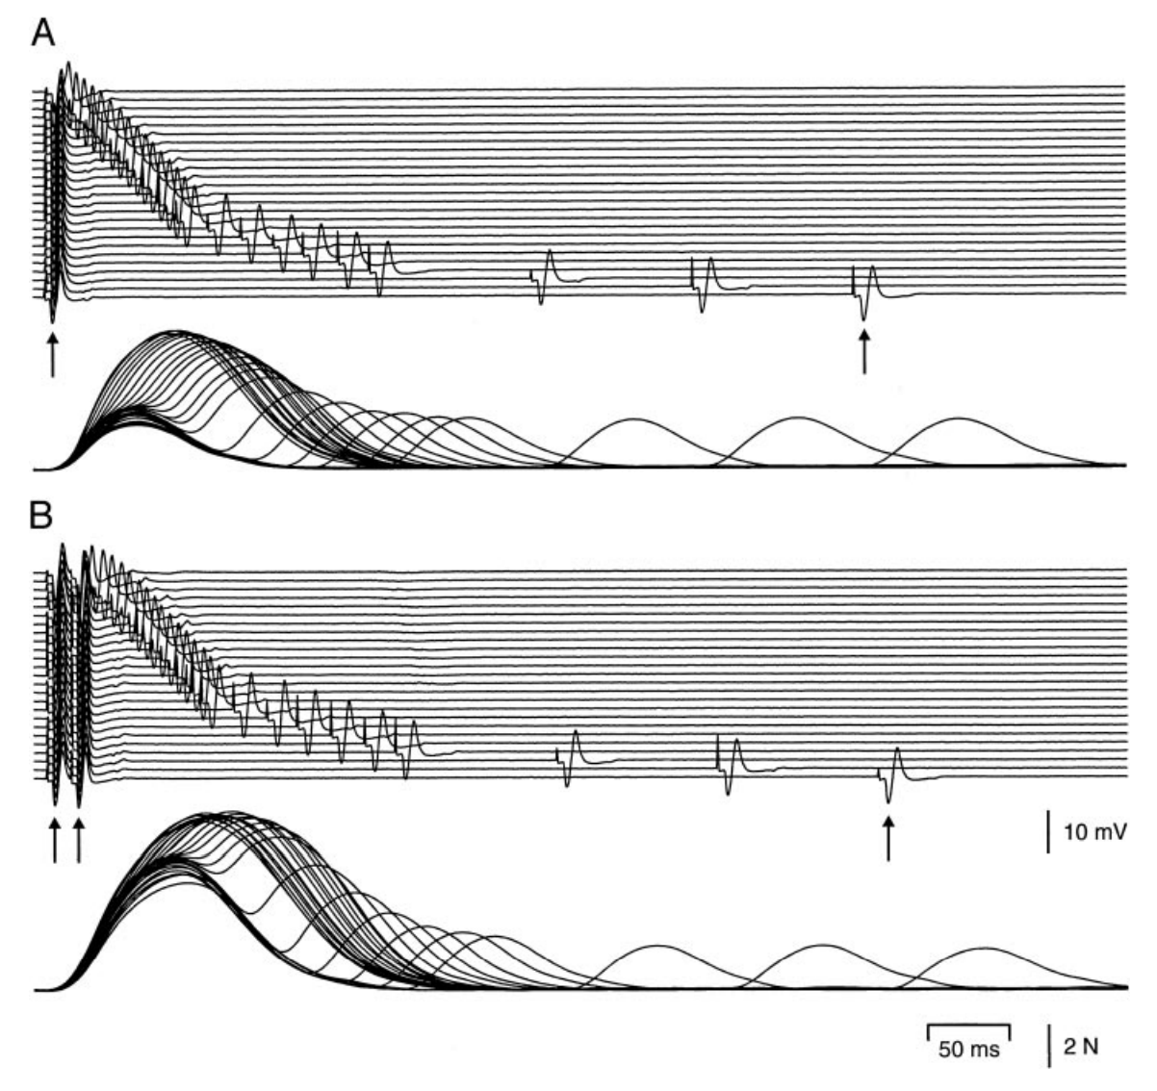
We hypothesize that we can use biologically inspired neural controllers that send pulse signals to muscle actuators in order to modulate force output and duration.
Stimulation Pattern That Maximizes Force in Paralyzed and Control Whole Thenar Muscles | Journal of Neurophysiology. https://www.physiology.org/doi/full/10.1152/jn.2002.87.5.2271?url_ver=Z39.88-2003&rfr_id=ori%3Arid%3Acrossref.org&rfr_dat=cr_pub%3Dpubmed. Accessed 23 Jan. 2020.

Slide 21
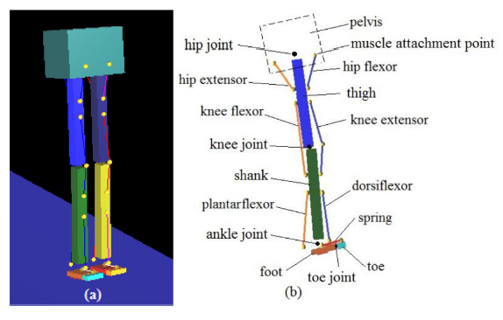
This 2-layer CPG bipedal neuromechanical model was created when we synthesized two existing designs.
Li, Wei, et al. “A Neural Network with Central Pattern Generators Entrained by Sensory Feedback Controls Walking of a Bipedal Model.” Bioinspiration & Biomimetics, vol. 12, no. 6, Oct. 2017, p. 065002. Institute of Physics, doi:10.1088/1748-3190/aa8290.
Deng, Kaiyu, et al. “Neuromechanical Model of Rat Hindlimb Walking with Two-Layer CPGs.” Biomimetics, vol. 4, no. 1, Mar. 2019, p. 21. DOI.org (Crossref), doi:10.3390/biomimetics4010021.

Slide 22

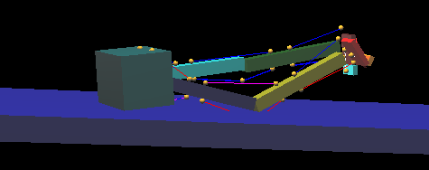
The synthesis Animatlab model approximates human gait while suspended in the air...
but it fails when attempting self-supported bipedal locomotion.

Slide 23
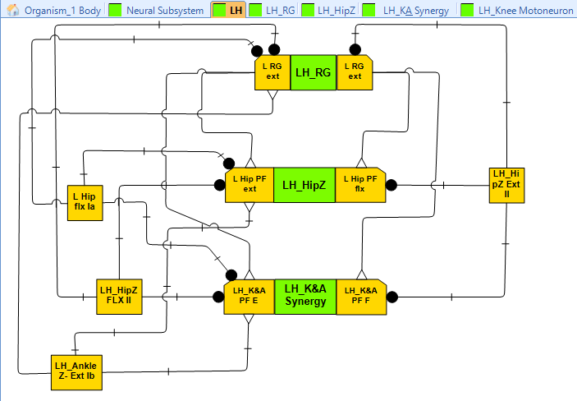
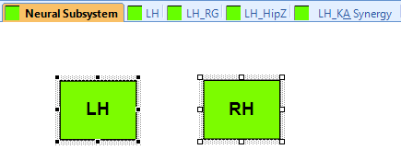
Accuracy will be increased by having a RG for each side, and it will incorporate proprioceptive feedback to the RG and PF layers
flx

Slide 24
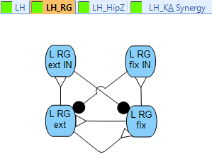
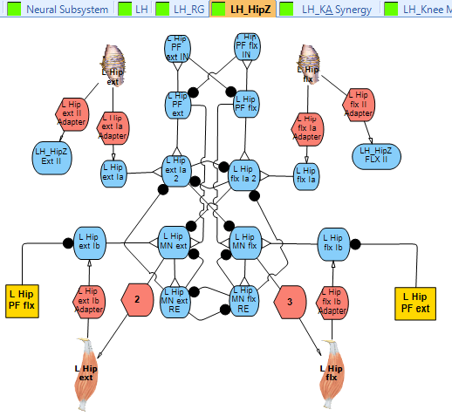
Multiple subsystems will make neural modeling easier to understand and diagnose.

Slide 25
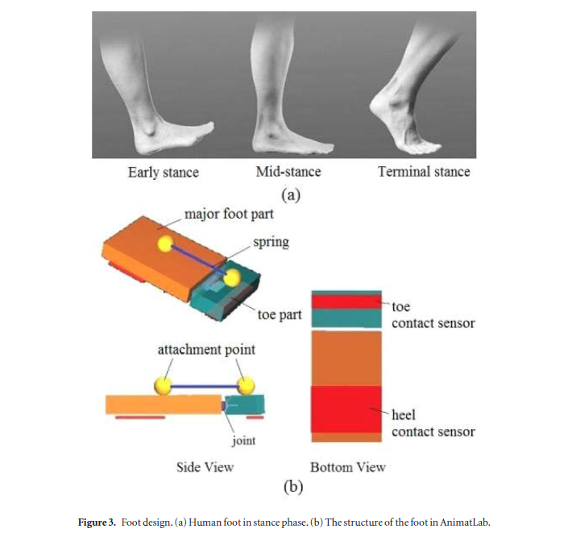
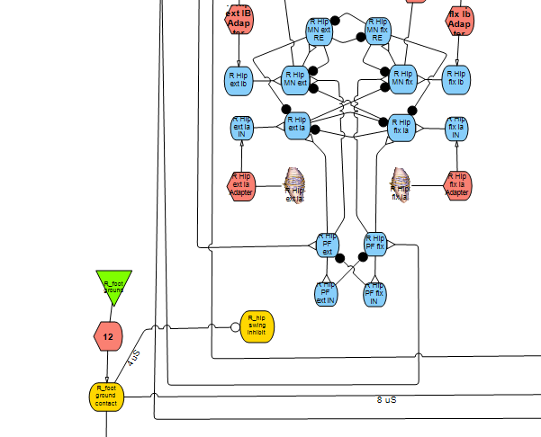
The neural controller model will be improved by incorporating contact feedback from foot mechanoreceptors.

Slide 26
I hope that this presentation let you learn more about our:
Robot development
Neural controller development
Future work to integrate both these things

Slide 27

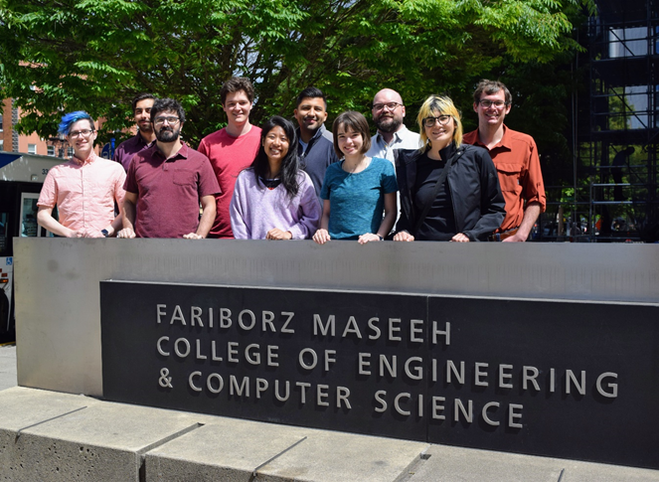


Thank you

Slide 29
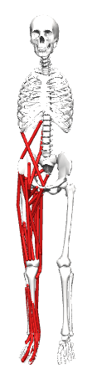
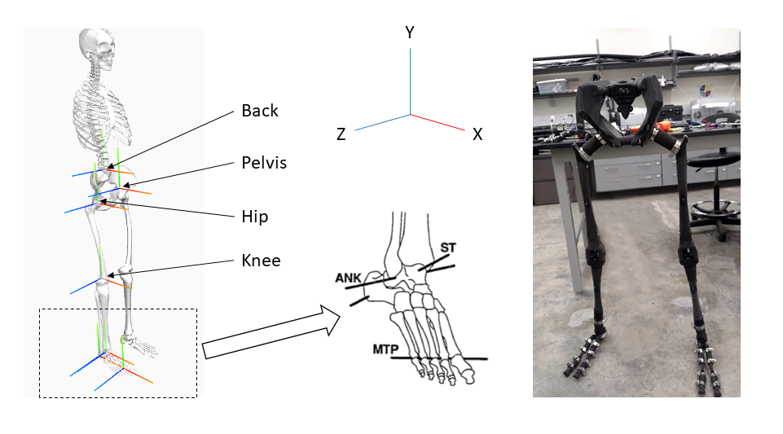
Our biomechanical model has good fidelity to real human bodies because it uses 11 total joints and 92 muscle-actuators (46 per side).

Slide 30
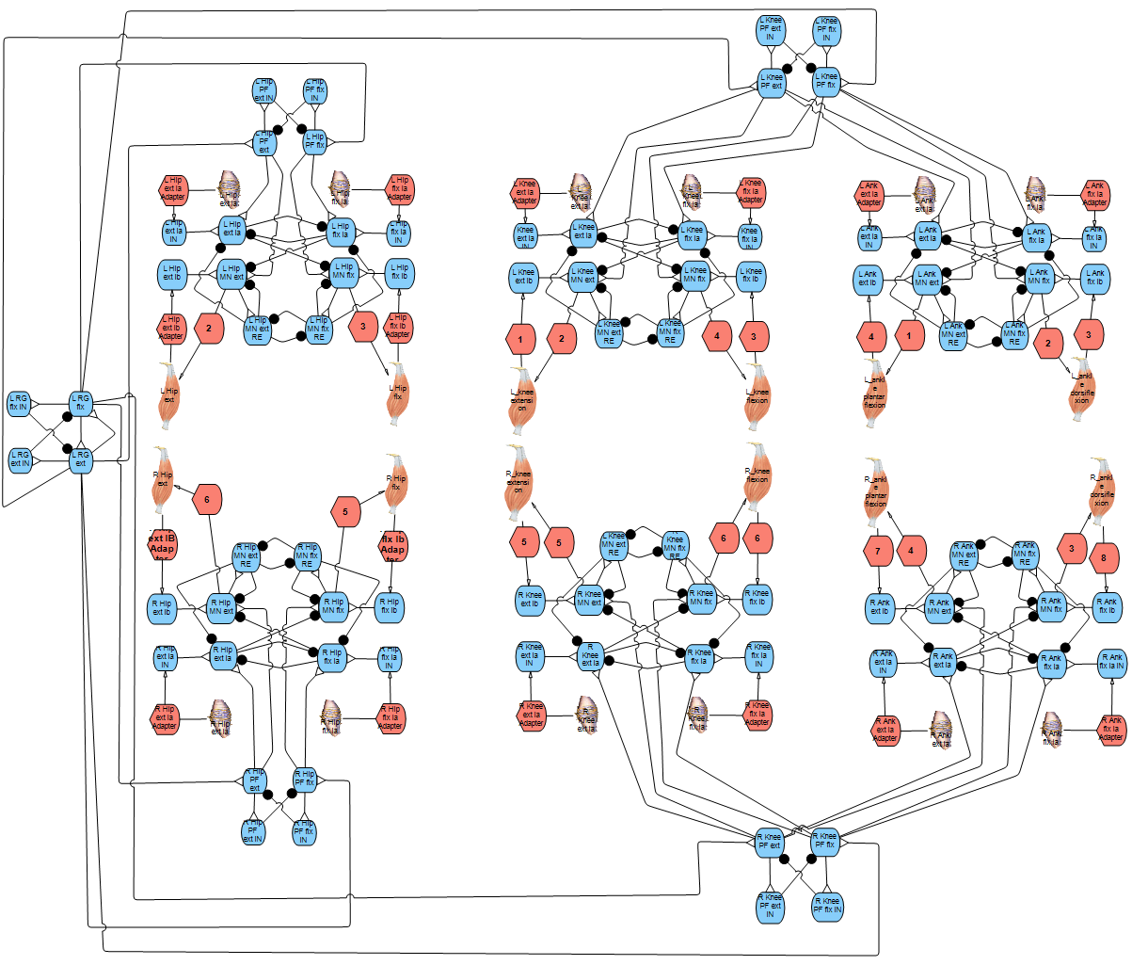
The 2-layer neural controller model has one overall Rhythm Generator (RG) layer, one Pattern Formation (PF) layer for each hip, and one PF layer for the knee and ankle of each side.
Sensorimotor Layer

Slide 31
Robot control will be achieved by combining our neuromechanical model with the previously mentioned skeletal geometry and pneumatic artificial muscles.

